Slide 1
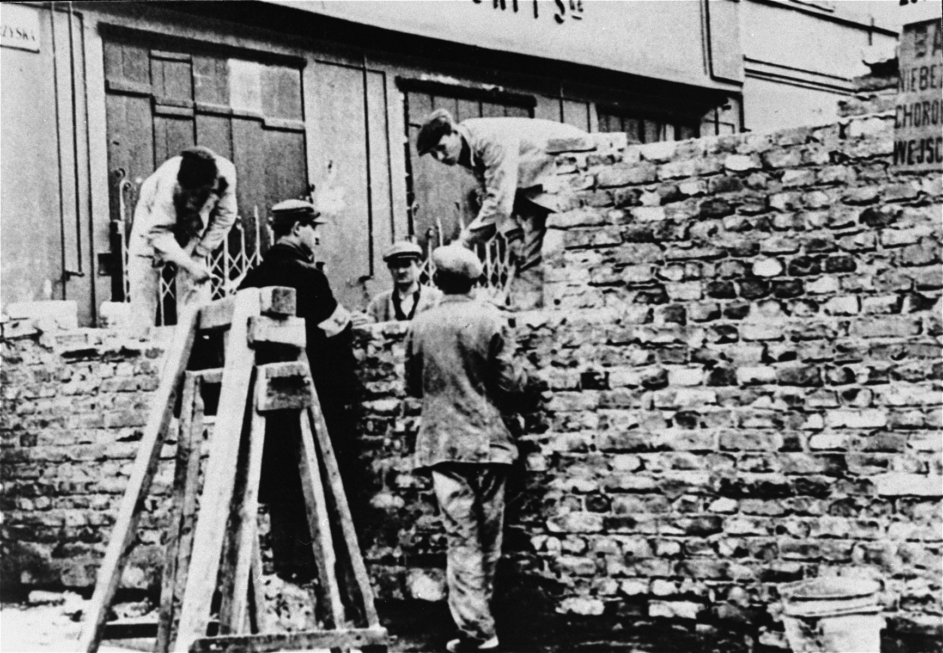




Road of Resistance: Three Women’s journeys in defying the Nazis
Photo credit: USHMM no. 37295
Polish and Jewish laborers construct a section of the wall that separated the Warsaw ghetto from the rest of the city

Slide 2

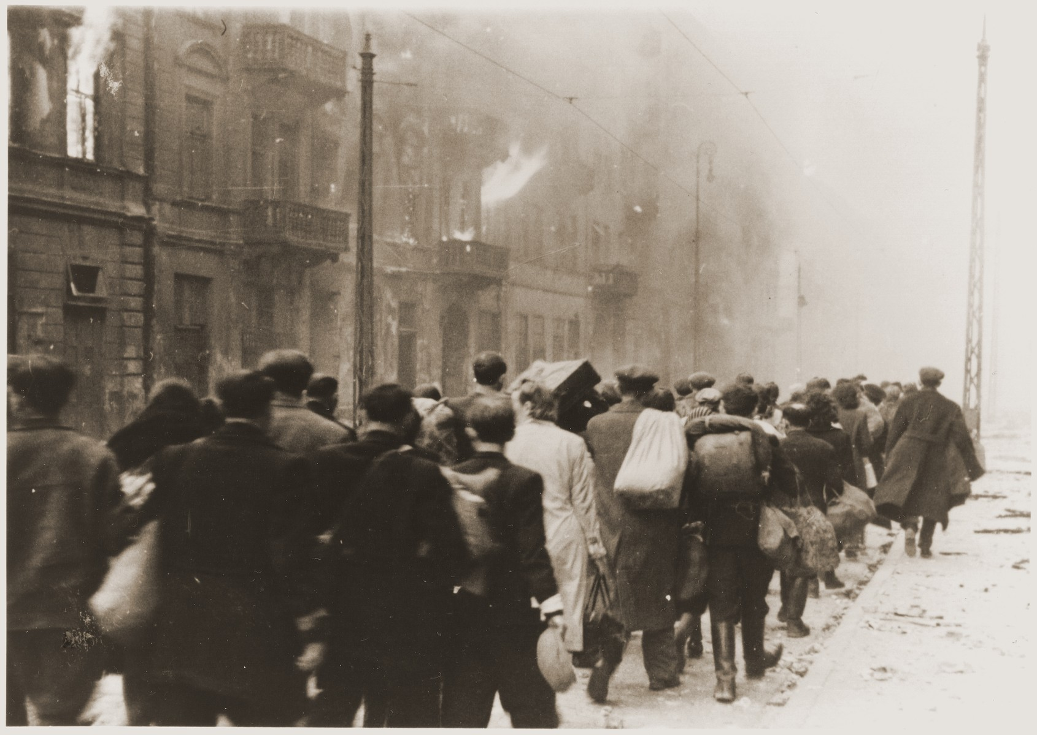
Photo credit: USHMM no. 265537
Will be a digital exhibit
Documenting and evaluating the stories of three women: Frumka Plotnicka, Vladka Meed, and Hannah Senesh
  Their life before the holocaust, their activities during the war
  Explore the theme of return
Designed to be similar to a website with multimedia components
Will be sent out in installments-one section per week
  After 5 weeks will be able to access the digital exhibit as a whole on the websites of collaborating museums
Jews captured during the Warsaw ghetto uprising are marched to the Umschlagplatz for deportation
Notes:
This will be a digital exhibit dedicated to documenting and evaluating three Jewish women, Frumka Plotnicka, Vladka Meed, and Hannah Senesh, who joined the resistance during the Holocaust. It will cover their lives before the war and how they participated in resisting the Nazis. It also explores the theme of return. All these women had opportunities to escape or already had escaped but they chose to return and help their fellow Jews.
This exhibit is designed in a website format but with other media components. It will feature a background with media on top and will utilize the scrolling effect. This will make it more accessible as well as aesthetically pleasing. It is not just pictures of a physical exhibit that one can hover their mouse on an icon and get information.
Road of Resistance will be emailed in 5 installments to subscribers of the museums that this project collaborates with. Once all 5 installments are out, the exhibit in its entirety can be accessed on these museums’ websites.

Slide 3
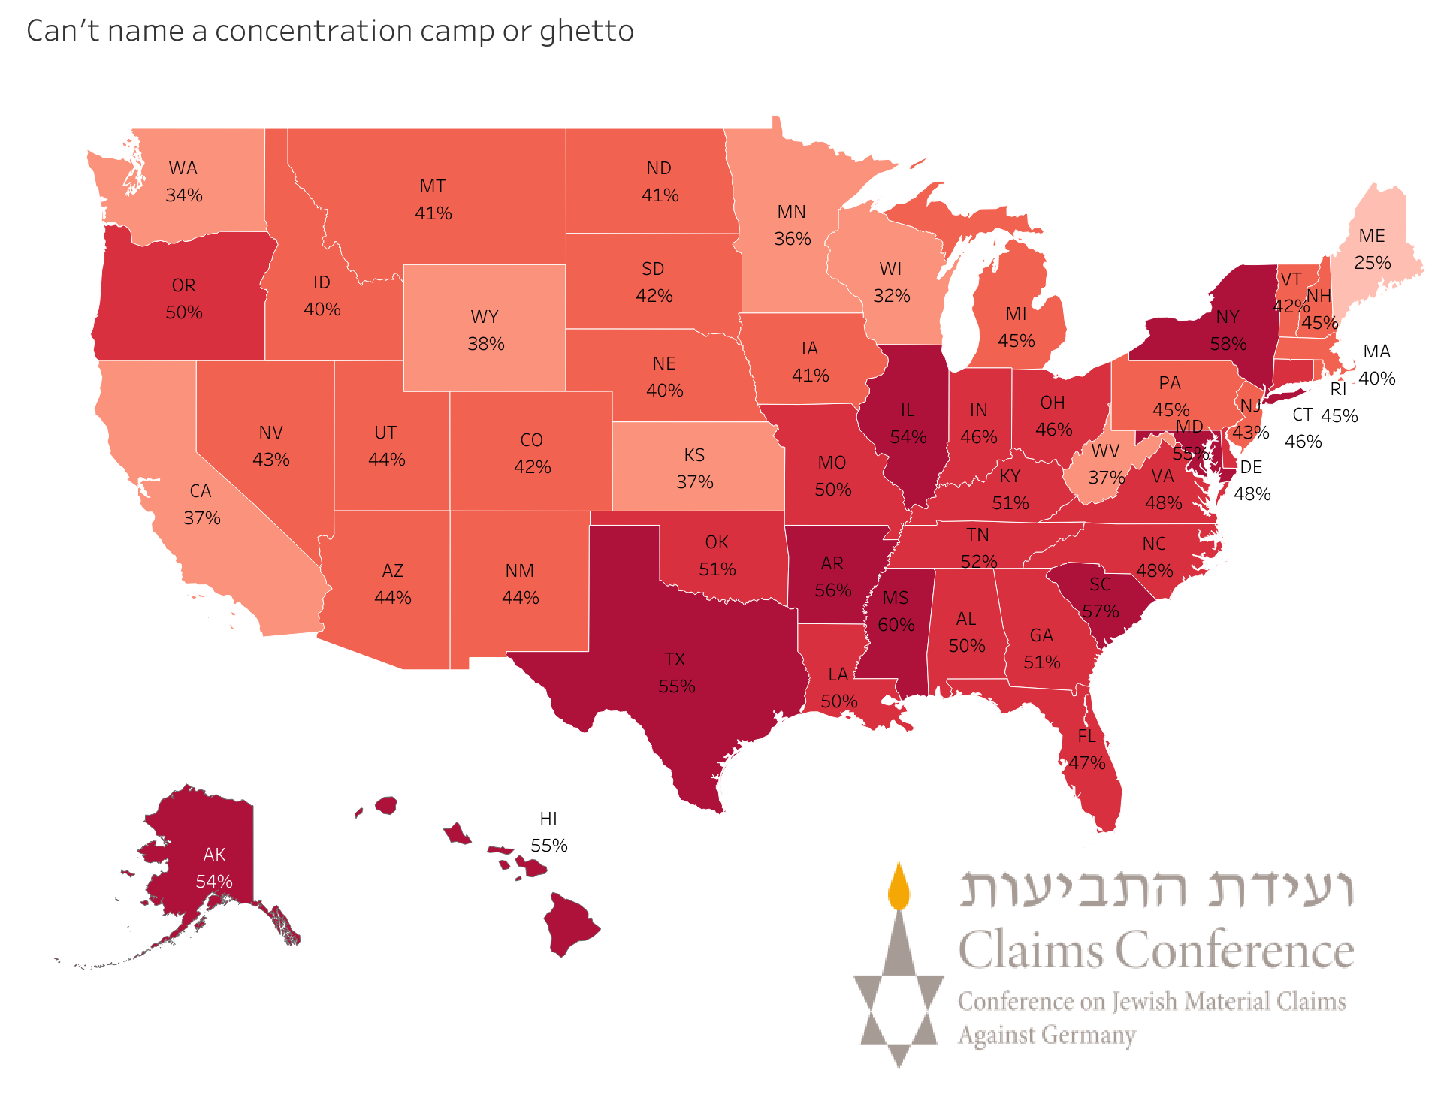
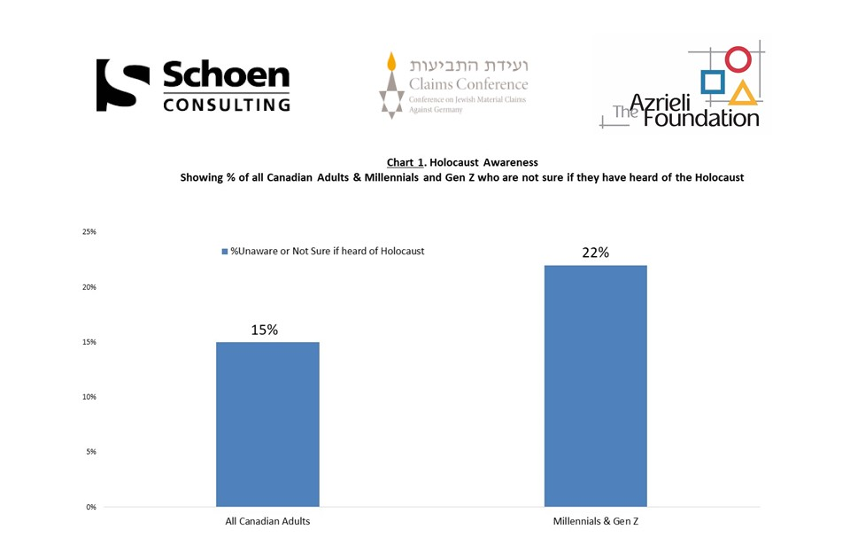
Objectives:
Primary objective-education; to illustrate the lives of these three female resistance fighters
Secondary objective- to dispel the myth that Jews did not try to prevent or hinder their executions
target audience:
Gen Z and Millennials
In America in 2020, 48% of young adults and teenagers could not list any ghettos or concentration camps
The same type of study was conducted in 4 other countries: United Kingdom, France, Austria, Canada
  They yielded similar results
Notes:
The primary objective of this project is education. Not many people have heard of the female fighter's courageous acts during the Holocaust. Their stories were swept under the rug or other horrors of the Holocaust, such as the concentration camp supplanted their actions in the public’s eye. Two out of the three women discussed in the exhibit did not survive. It is our responsibility to tell their stories and continue their legacy.
The secondary objective is to dispel the myth that Jews “went like sheep to the slaughter.” There were 30,000 Jews who joined existing resistance groups or started their own. Looking at this digital project, one will learn that resistance did happen and that some of the leading figures were not all men many were women.
This project is designed to target the Gen Z and Millennial groups. A survey conducted in America in 2020 showed horrifying results. 48% of this group were unable to name any ghetto or concentration camp. Similar surveys were conducted in other countries around the world with comparable results. The top survey shows which states are lacking Holocaust knowledge. For instance, New York has a high percentage with 58% of people who cannot name a ghetto or camp. The bottom picture is a survey conducted in Canada. In this case 15% of adults in addition to 22% of Gen Z and Millennials were not sure if they heard about the Holocaust. With this digital platform, this exhibit guarantees national and global access to fill the gaps in Holocaust knowledge.

Slide 4
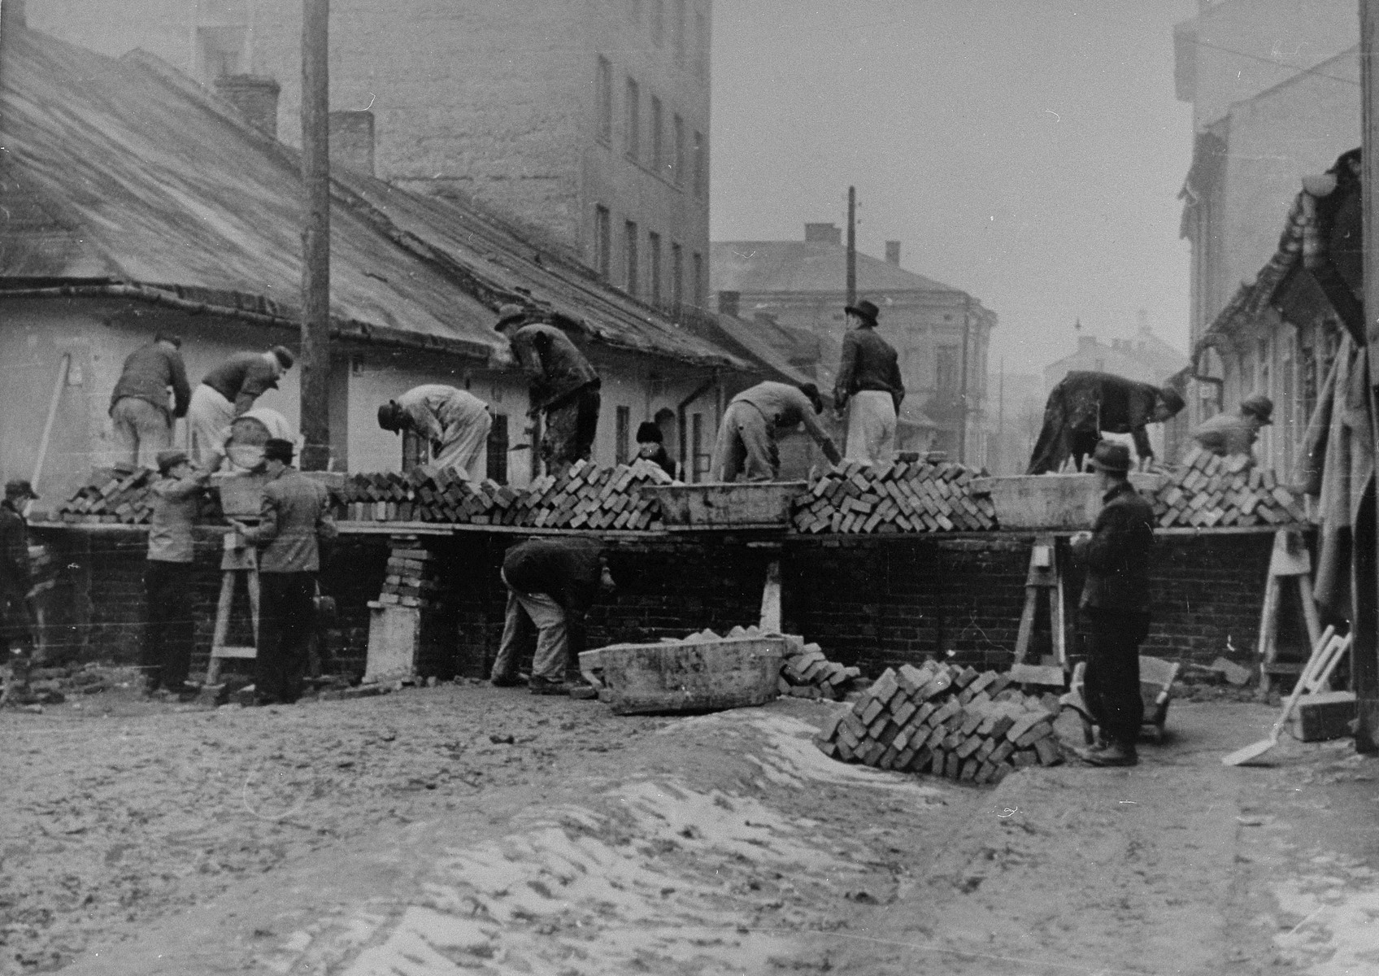
Part One: Ghettoization
Brief background of Adolf Hitler’s rise to power as chancellor of the Third Reich
Start of World War Two and the Nazi invasion of Poland
Actions taken against the Jews
  Ghettoization
  The rise of the Jewish underground and resistance movements
    smuggling weapons
    encourage fighting
    ignoring Nazi orders
Photo credit: USHMM no. 39064
Forced laborers constructing the wall around the Krakow ghetto
Notes:
The first section will begin with a brief background of how Adolf Hitler became chancellor of Germany and the start of the Third Reich. It will then discuss the start of World War Two and the Nazi invasion of Poland. Once the Nazis came to Poland they started to target the Jews almost immediately. The Nazis gathered the Jews into ghettos which were parts of the city that were physically walled off and isolated and weakened the population. It was there that the Jewish resistance was organized. Originally established in the Warsaw ghetto, the ZOB, the Jewish fighting organization sent fighters to other ghettos to start further resistance movements. Resistance took the form of smuggling in weapons, publishing material encouraging fighting, and trying to get the people to ignore Nazi orders like reporting to the Umschlagplatz to be (quote)"resettled" (end quote) in exchange for a meager sharing of food.

Slide 5
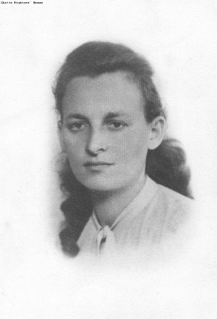
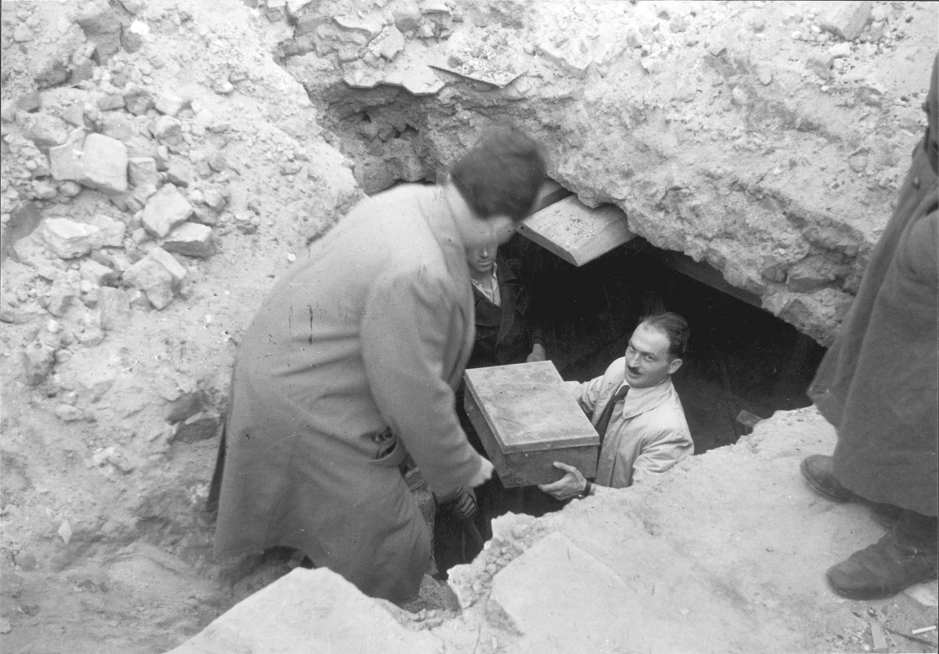
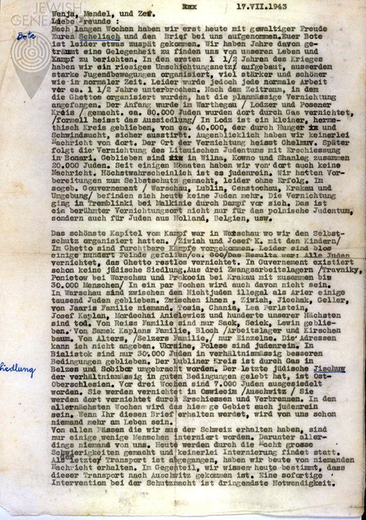
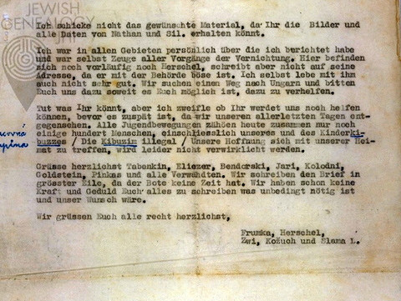
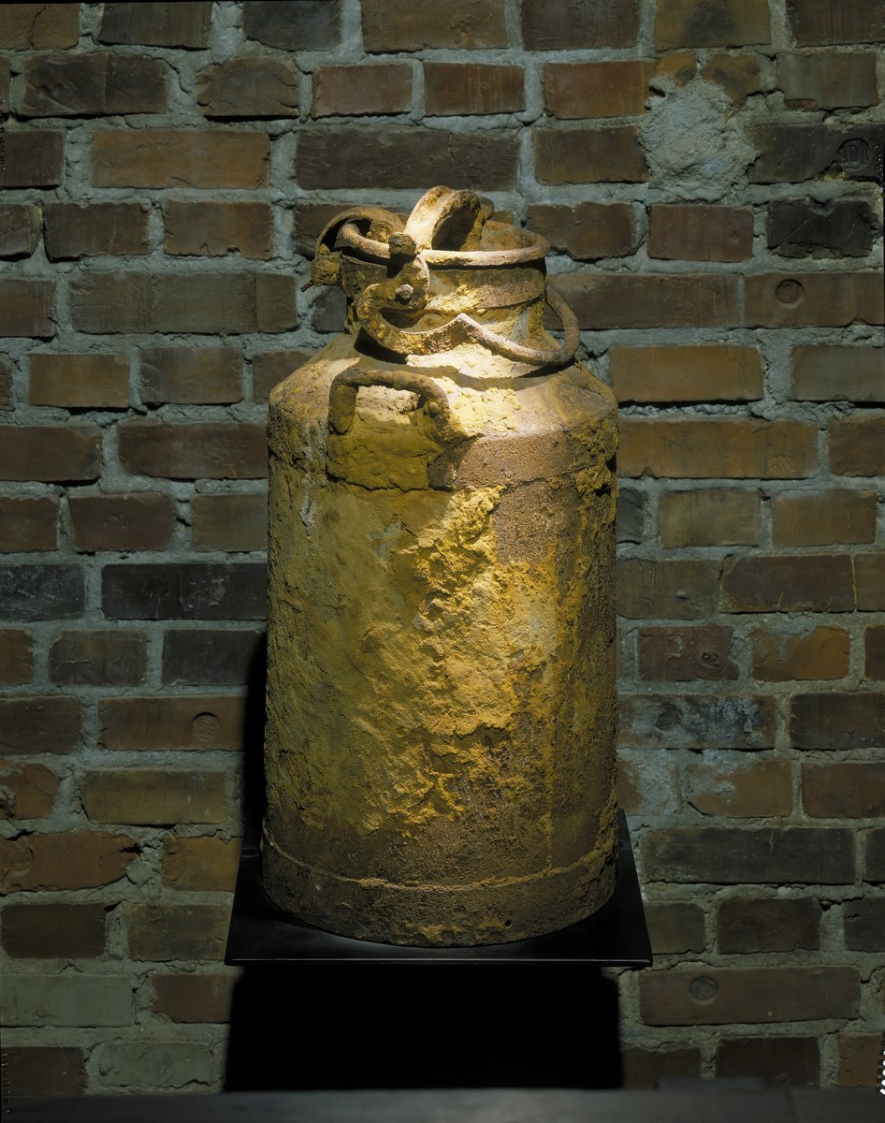
Photo credit: Ghetto Fighters Museum catalog no. 1261
Photo credit: Yad Vashem ID no. 11621
Photo credit: Jewish Historical Institute
Warsaw, Poland, Unearthing of the hidden "Oneg Shabbat" archives after the war
Photo credit: USHMM no. N02423
The last letter from Będzin
Frumka Plotnicka, member of the Dror youth movement and the Jewish Fighting Organization in the Warsaw ghetto
Frumka Plotnicka
One of the milk cans used by Warsaw ghetto historian Emanuel Ringelblum to store and preserve the secret "Oneg Shabbat" ghetto archives
Notes:
The first women depicted in the project is Frumka Plotnicka. Plotnicka was born to a chassidishe or Chassidic family in 1914 in Belarus. She became part of Zionist groups as a teenager. In the summer of 1939, she was supposed to emigrate to Israel but was asked by the group's leadership to remain in Europe. As the Nazis invaded, Plotnicka remained in Warsaw and became a fighter in the resistance movement. She was chosen to be a courier and bring information to other Jewish communities about the deportations to the East. After the mass deportation in Warsaw the ZOB sent her to Bedzin to organize the uprising there. Plotnicka was murdered in the liquidation of the ghetto on August 1, 1943.
On a personal note, the reason I chose Plotnicka was because I felt some sort of connection to her. I had family who lived in Bedzin and Sosnoweic. They were considered sister cities and shared the same Judenrat. According to family legend my grandmother who resided in Sosnoweic, was taken by the Nazis at the ripe old age of 94. On the other hand we do not know the fate of the rest of the family. For all I know they were confined in the ghetto with plotnicka, perhaps even engaging with her and participating in resistance?

Slide 6
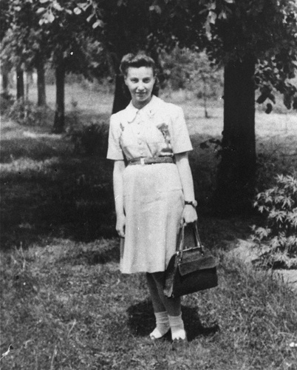
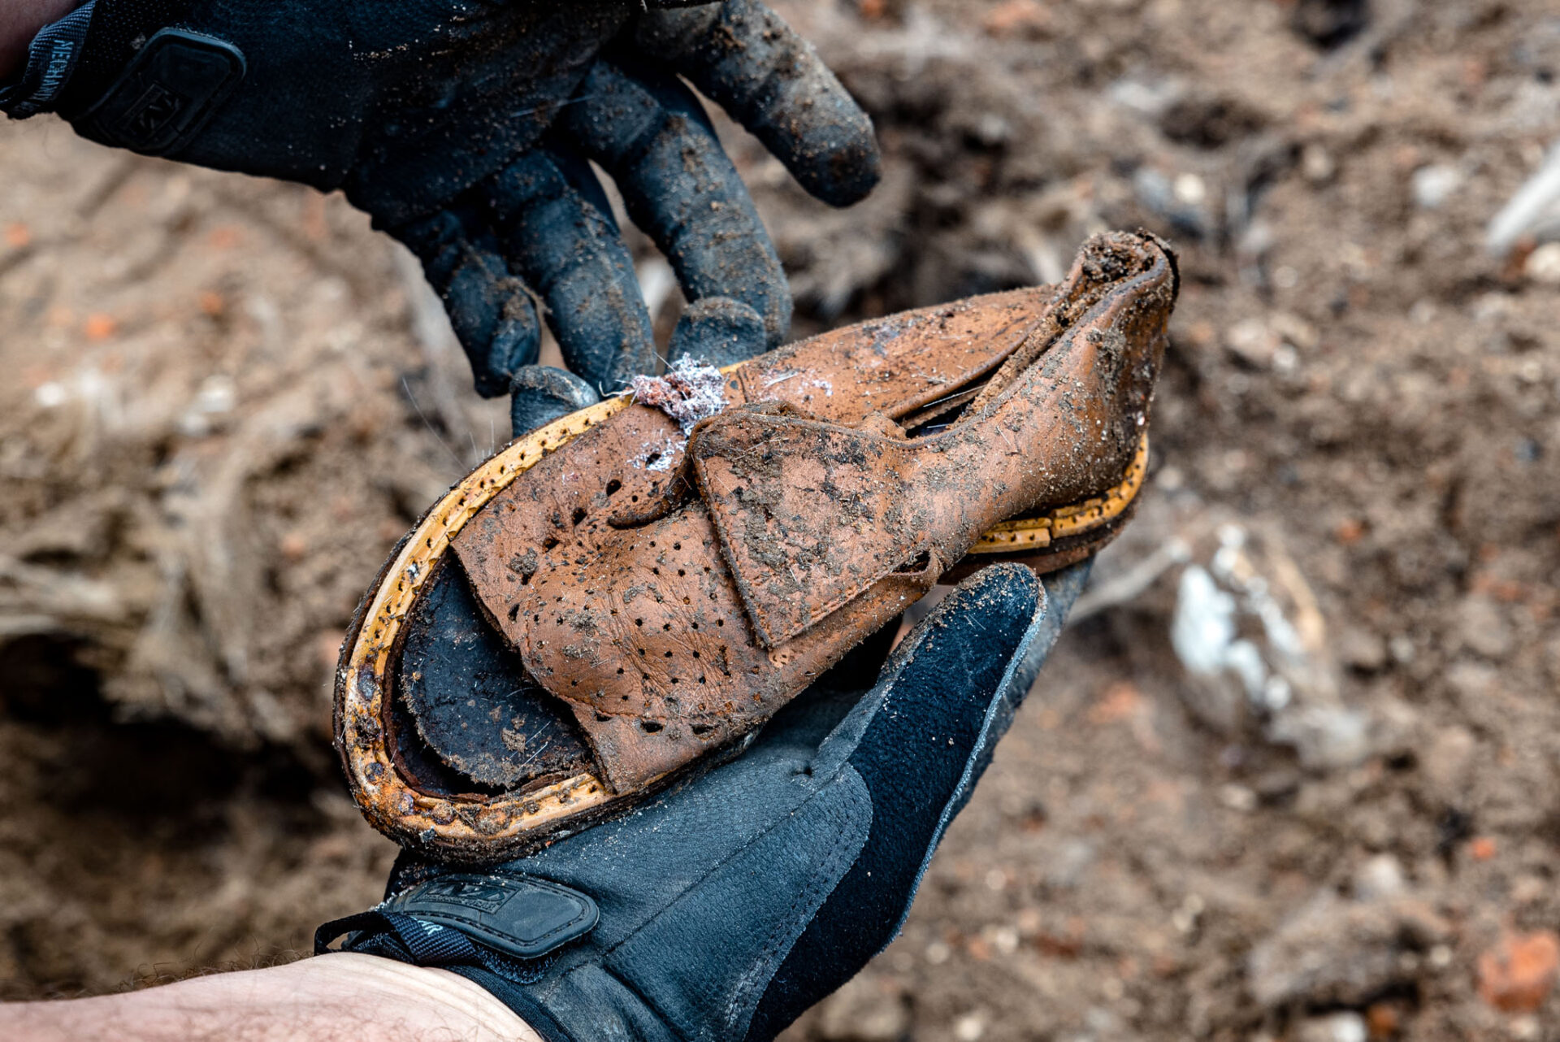
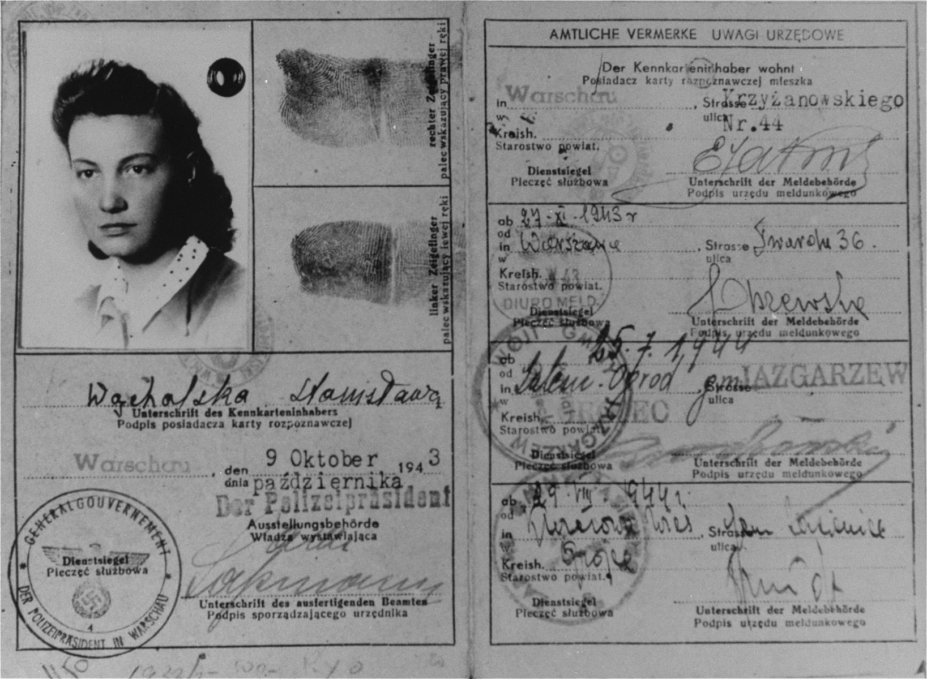
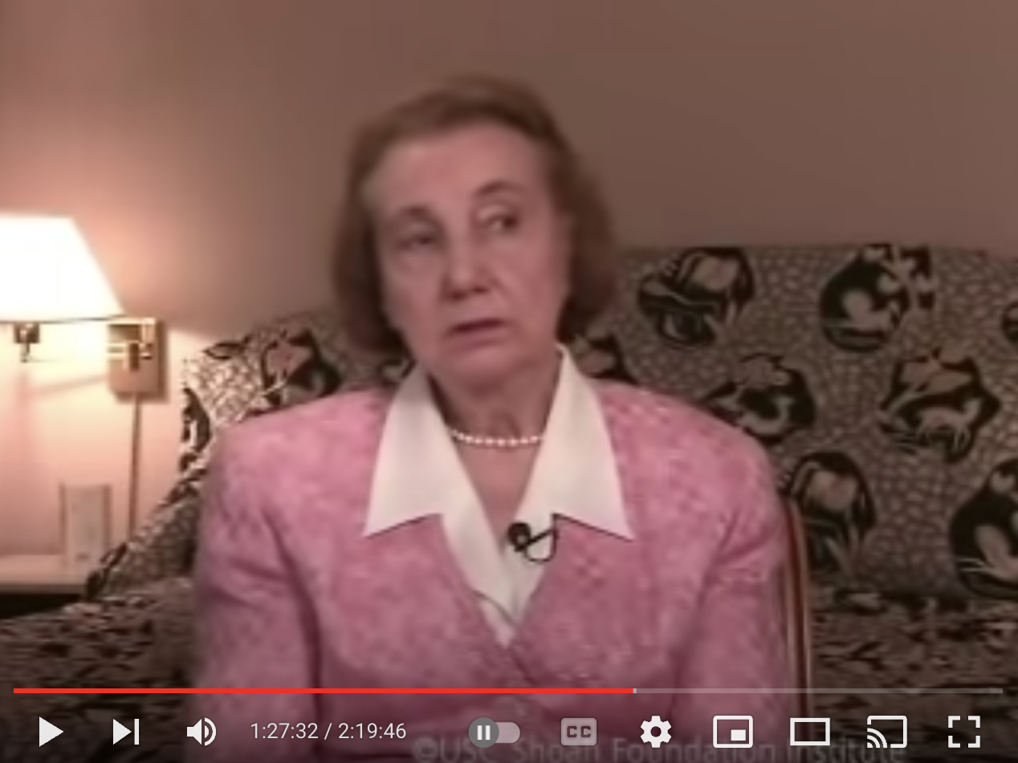
Photo credit: USHMM no. 02346
Photo credit: Warsaw Ghetto Museum Robert Wilczyński
Photo credit: USHMM no. 02325
Shoe found in excavation of the Warsaw ghetto
False identification card issued in name of Stanislawa Wachalska, that was used by Feigele Peltel (now Vladka Meed) while serving as a courier for the Jewish underground in Warsaw.
Courtesy of the USC Shoah Foundation
Feigele Peltel (now Vladka Meed) on one of her missions as a courier for the Jewish underground.
Vladka Meed
Holocaust Survivor Vladka Meed Testimony
Notes:
The next section is dedicated to Vladka Meed . Meed was born into a traditional Jewish family in Warsaw in December 1921. As a teenager she joined the local socialist movement and when the time came she was forced into the ghetto with the rest of her family. Her father died of pneumonia in the ghetto and her mother, brother, and sister were deported to Treblinka. She was left alone, the sole survivor of her family. With nothing to lose, she joined the resistance and was chosen to live on the Aryan side with her “polish look.” She smuggled in arms to the ghetto and secreted children out of the ghetto. Meed survived the war, married and built a family. She came to America and championed holocaust education.

Slide 7
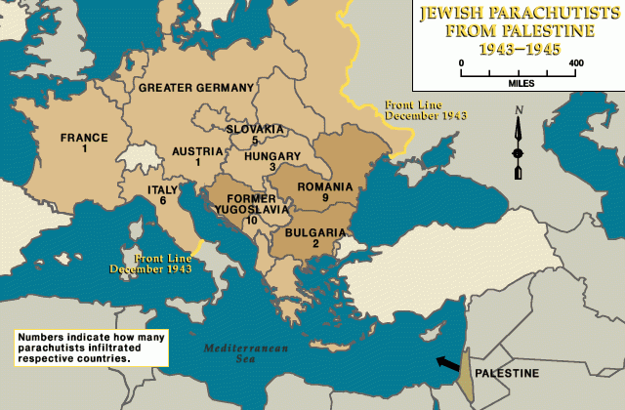
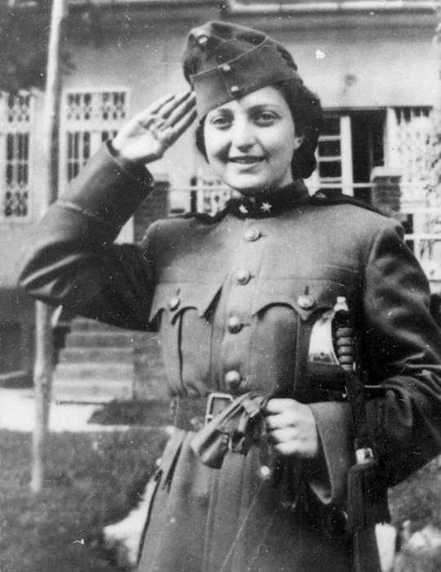
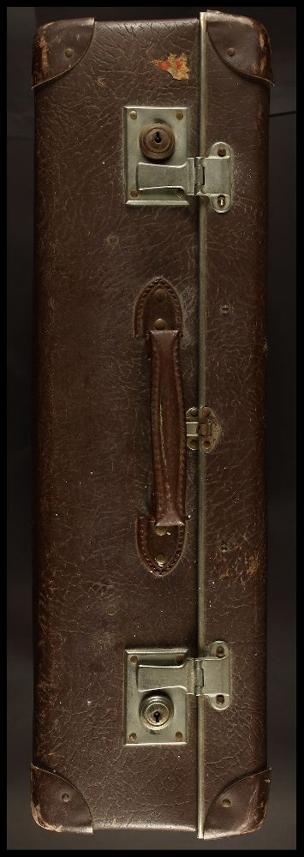
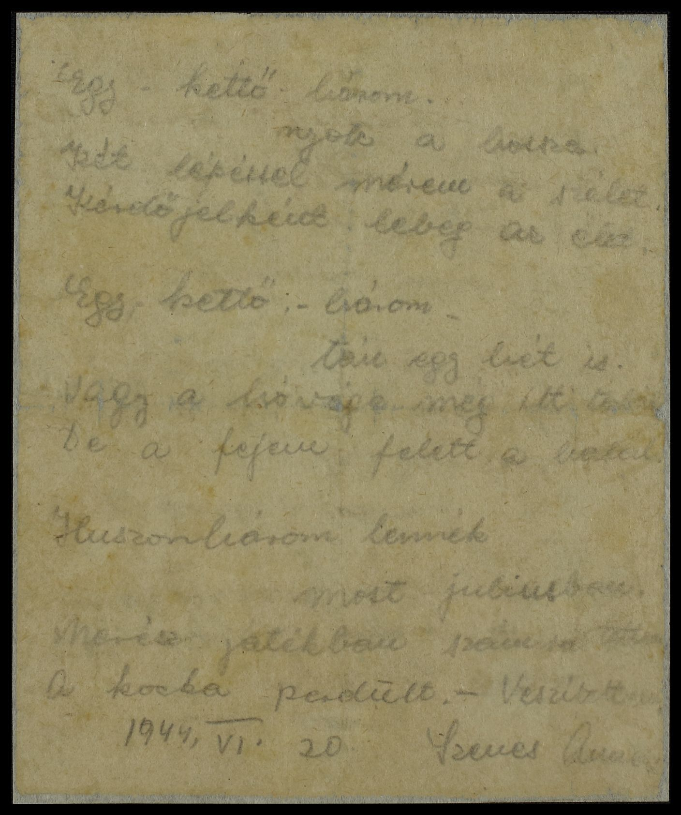
Photo credit: USHMM
Photo credit: Yad Vashem ID no. 3213/2
Photo credit: Senesh Family Archive, with thanks to Ori and Mirit Eisen
Photo credit: Senesh Family Archive, with thanks to Ori and Mirit Eisen
Hannah Szenes (Senesh)
Hannah Senesh
Letter from Senesh to her mother found in her pockets after her execution
Notes:
The last women this project talks about is Hannah Senesh who was born in 1919 in Hungary. Senesh was already felt antisemitic restrictions in 1939 and emigrated to Israel. In 1943, she volunteered in the British army as a paratrooper. Codenamed “Hagar,” her mission was to infiltrate enemy territory and make contact with local partisans. She was also supposed to aid allied pilots who had had to bail out of their aircrafts. In 1944, Senesh was dropped in Croatia and worked with the partisans there for a few months. She was then captured trying to cross the border into her native hungary in June of 1944. Senesh was prosecuted as a British spy and a traitor to Hungary. She was executed in November 1944 at the age of 23.

Slide 8
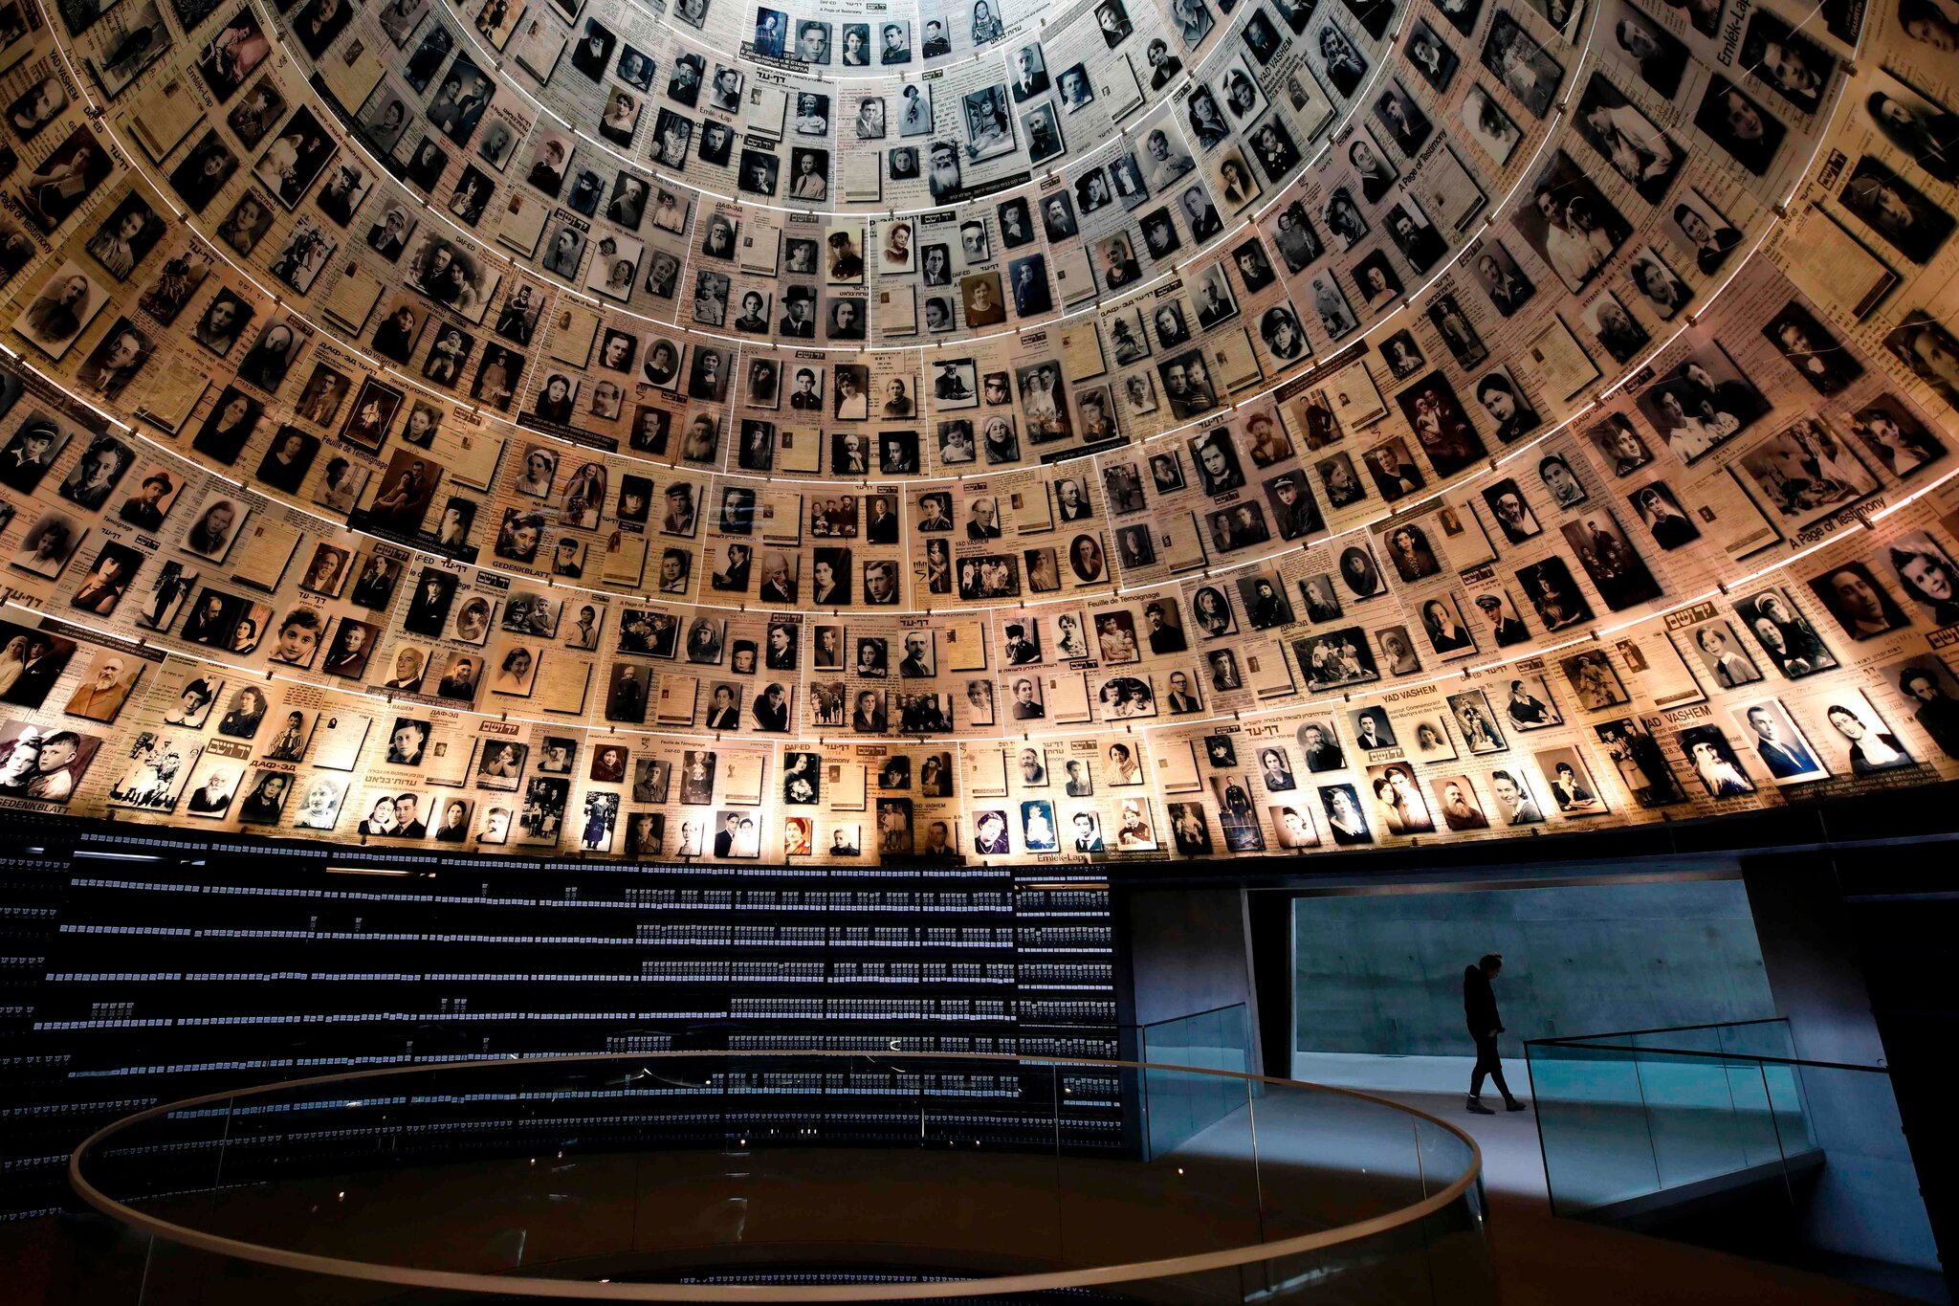
Reflection:
Did the Jewish resistance accomplish anything?
  Armed resistance
  Spiritual resistance
If you were in a similar situation, what would you do?
When faced with an opportunity to save yourself, would you return to the danger to help others?
When faced with oppression, what do you do?
Background image of the Hall of Names at Yad Vashem
Notes:
The last section is one of reflection. It will start with discussing the effectiveness of the Jewish resistance. Before, though, the word resistance needs to be defined which is a debate among Holocaust scholars. For example, is resistance defined in physical terms like with weapons and force or can it be spiritually defined? Do we consider the Jews who practiced their laws and customs to the best of their ability as resisting? Once the differences are explained the section will continue to discuss what happened with the Jewish resistance movements. Finally, the section will leave the user with reflection questions such as when faced with an opportunity to save yourself, would you return to the danger to help others? When faced with oppression what do you do?

Slide 9
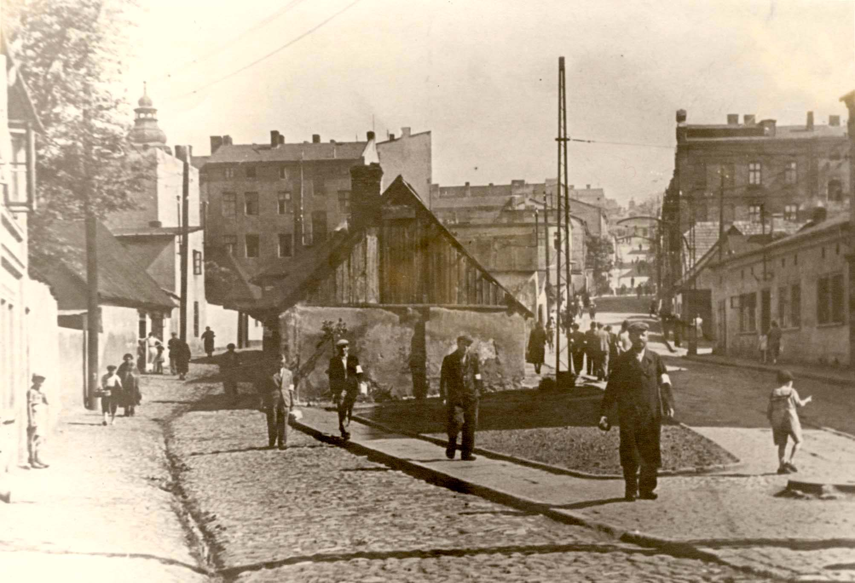
Opposition:
Colleague opposition to this being a female run project focusing only on women
Differing of opinion by Holocaust scholars about the definition of resistance
Public Reaction:
Favorable- women will like to learn about these stories that were never in the spotlight
Unfavorable-backlash from Poland
  Holocaust denial
Photo credit: Yad Vashem ID no. 97273
Bedzin, Poland, A street in the ghetto
Notes:
There is a potential for opposition from colleagues. It can stem from the fact that this is a female run project and focuses on women. Male public historians may not value this project and will not peruse it or recommend it to others, limiting its scope.
Other opposition can come from Holocaust scholars, as we said above, who define resistance differently. They might not like how this project focuses on armed physical resistance and does not discuss spiritual resistance. This however, is not intentional, the project just needed to be capped somewhere.
Public reaction may be diverse. The stories of Jewish female resistance fighters are not commonly known. When hearing about the resistance, people usually think of the leading male fighters such as Mordechai Anielewicz or the Bielski brothers. Many women will be interested to learn that the resistance movements had many female fighters and leaders.
An adverse reaction to this project might come from Poland. Public History projects “reevaluate the facts.” Many Poles will not want their relationship with the Nazis to be reevaluated due to research for this project. In fact, Poland recently passed a law making it a civil offense to say that Poland was complicit with Nazi actions. Although there might be some who will not like this exhibit, but these women’s stories must be told.
Unfortunately, there are also people in the world who deny that the Holocaust occurred. They will not like this project based on the simplistic fact that it details what happened. It even brings witness testimony to make the evidence irrefutable.

Slide 10
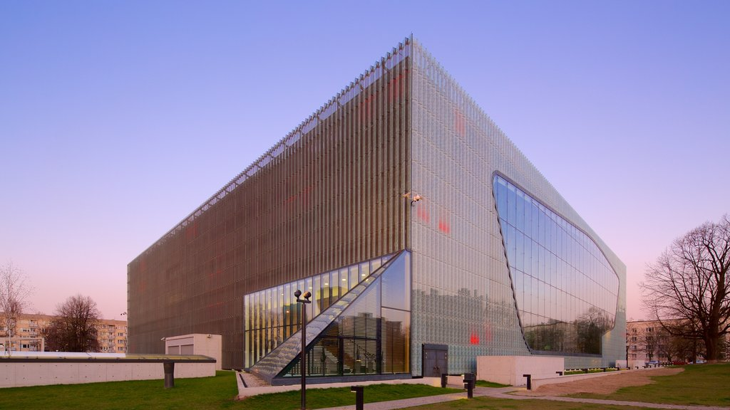
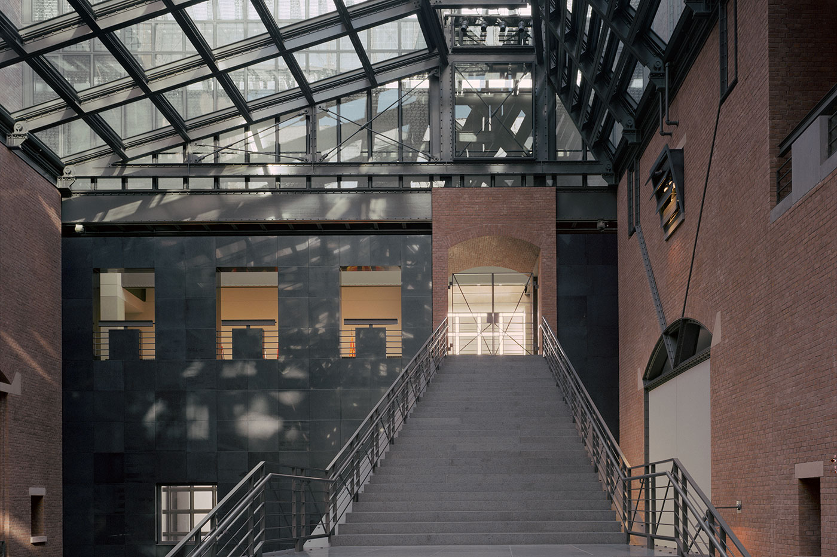

Development Plan
Outreach:
POLIN Museum of the History of Polish Jews
United States Holocaust Memorial Museum
Notes:
A crucial place to start the development plan for this project is with education. This digital project looks to collaborate with an exhibit marking the 80th anniversary of the Warsaw Ghetto uprising at the POLIN Museum of the History of Polish Jews. The physical exhibit talks about civilian life in the warsaw ghetto and Road of Resistance would give the female perspective. This would assist in global outreach.
The next collaboration this project would look to is with the United States Holocaust Memorial Museum USHMM. They have started a Digital Humanities Associate Fellowship program to increase their digital strategies and outreach. Fellows conduct their own projects and research and this exhibit can be a viable option for them to research. This would contribute to national outreach.
The third option for outreach is to coordinate with the Jewish Partisan Educational Foundation. They have created a curriculum which includes a special focus on women partisans. Partnering with this institution would allow for this digital project to be incorporated into their curriculum and disseminated into numerous classrooms.

Slide 11




Funding:
Notes:
There are a few options for funding for this digital exhibit. The first option is the New York State Council on the Arts. This council helps fund exhibits to further cultural activities of museums. This council already has a relationship with Holocaust museums and has funded a few exhibitions like the newest exhibit at the Museum of Jewish Heritage named The Holocaust: What Hate Can Do.
Another possibility for funding can come from the Claims Conference, a nonprofit organization that originated with reclaiming stolen property and assets for Jewish victims. It now has branched out in into (quote)“support[ing] projects that further Shoah education, documentation, research, and film.”(end quote)
Additionally, this project looks to secure funding from the International Holocaust Remembrance Alliance (IHRA). The IHRA has a few criteria that a project must meet to obtain a grant. The first is to protect knowledge about the Holocaust and ensure that it's not distorted. The other objective is that the project must expand awareness and relevance of the Holocaust. Road of Resistance fulfills both objectives by highlighting the stories of women who led and participated in resistance activities against the Nazis. It also gives the public previously unheard stories of these women and shows women today that they can be leaders in change or stand up to injustice.
In 2020 President Trump signed the Never Again Education Act into law which designates funds to expand USHMM’s reach across the country and to an online archive of teaching material about the Holocaust. This digital repository can include Road of Resistance so teachers can incorporate women partisans into their curriculum. Using these funds for this project will not only help this project get off the ground but will give a valuable resource in increasing Holocaust awareness nationally.

Slide 12

“The story of the Jewish woman will be a glorious page in the history of Jewry during the present war.”
-Dr. Emanuel Ringelblum
Background image of the Children’s Memorial at Yad Vashem
Notes:
Three women had a chance at survival, yet all three returned to fight. Only one lived to talk about her experiences. As Dr. Ringelblum wrote in his diary (quote) “the story of the Jewish woman will be a glorious page in the history of Jewry during the present war.” (end quote) It is our responsibility to ensure that the future generations know of their sacrifices and heroism.
Who knows if we were faced with the same situation what would we have done? Would we have risked our lives to save our neighbors?

